Slide 1
FOUNDATIONS OF ARTIFICIAL INTELLIGENCE · PROJECT REVIEW
AI-Based Legal Assistant
Source-backed legal information for Indian citizens using an AI classifier and A* search
TEAM MEMBERS
Sajine Santhakumar
240701459
Roshini S
240701442
f(n) = g(n) + h(n)
Best path found by A*; dashed branches are pruned
Guided by: Mrs. Deepa
Notes:
Introduce the team and the project: an AI legal information assistant that uses a supervised-learning classifier and A* search (Unit II informed search) to retrieve source-backed answers about common Indian legal issues.

Slide 2
Problem Statement & Abstract
ABSTRACT
THE PROBLEM
The AI-Based Legal Assistant answers general legal questions about common issues in India. A supervised-learning classifier (TF-IDF + Logistic Regression) estimates the probability of each legal category. These probabilities become the path cost g(n) of an A* search over a START → Category → Entry state space, guided by an admissible word-coverage heuristic h(n) that prunes categories that cannot beat the best answer. A reliability threshold rejects weak matches instead of returning unrelated advice. Every answer shows its Act/section and official source, and the full A* trace is displayed for transparency.
Legal information is scattered across Acts, government portals and notifications.
Citizens describe the same issue in their own words, so exact-keyword FAQ search fails.
Chatbots that always return the closest answer can give unrelated, unsourced legal information.
Goal: identify the legal category, retrieve the best entry with A* search, cite the law and source, and refuse unreliable matches.
81
8
45%
6.2 / 90
curated legal entries
areas of Indian law
reliability threshold
nodes expanded by A* (avg.)
Notes:
Problem: legal information is scattered and people phrase questions differently; naive chatbots return unrelated answers. Our solution combines a learned classifier with A* search and a reliability threshold, and always cites the law and source.

Slide 3
Literature Survey (1/2)
Paper (title · authors · venue) | Methodology | Implementation | Advantages (+) | Limitations (−) | How our project overcomes it
[1] A Formal Basis for the Heuristic Determination of Minimum Cost Paths P. E. Hart, N. J. Nilsson, B. Raphael — IEEE Trans. SSC, 1968 | Best-first graph search ordered by f(n) = g(n) + h(n); proves optimality when h(n) never over-estimates (admissible). | Formal algorithm with proofs, evaluated on minimum-cost path finding in graphs. | Optimal and efficient; expands far fewer nodes than uninformed search. | Needs a good heuristic; open list can grow large; not designed for text retrieval. | We apply A* to legal retrieval with an admissible word-coverage heuristic; the 90-node tree keeps memory trivial.
[2] How Does NLP Benefit Legal System: A Summary of Legal Artificial Intelligence H. Zhong, C. Xiao, C. Tu, T. Zhang, Z. Liu, M. Sun — ACL 2020 | Survey of embedding-based and symbol-based Legal AI; experiments on judgment prediction, similar-case matching and legal QA. | Benchmarked existing models on Chinese legal datasets (e.g. CAIL, JEC-QA). | Clear taxonomy of Legal AI; stresses interpretability and knowledge. | Chinese datasets; legal QA accuracy far below humans; black-box models lack explanations. | Our assistant is explainable: shows path, g/h/f values, matched words, the Act and the source.
[3] LEGAL-BERT: The Muppets straight out of Law School I. Chalkidis, M. Fergadiotis, P. Malakasiotis, N. Aletras, I. Androutsopoulos — Findings of EMNLP 2020 | Further pre-training / pre-training BERT from scratch on ~12 GB of English legal text (legislation, cases, contracts). | Evaluated on legal text classification and sequence-tagging tasks (EU, UK, US data). | Better legal-language understanding than generic BERT; a small efficient variant. | Heavy compute (GPU); EU/US focus, not Indian law; outputs carry no citations. | Lightweight TF-IDF + Logistic Regression runs on a laptop CPU; curated Indian knowledge base with sources.
Notes:
Paper 1 is the original A* paper that guarantees optimal results with an admissible heuristic — the basis of our search. Paper 2 surveys Legal AI and highlights the need for interpretability. Paper 3 (LEGAL-BERT) shows domain language models help but are compute-heavy and not Indian.

Slide 4
Literature Survey (2/2)
Paper (title · authors · venue) | Methodology | Implementation | Advantages (+) | Limitations (−) | How our project overcomes it
[4] Improving Access to Justice with Legal Chatbots M. Queudot, É. Charton, M.-J. Meurs — Stats 3(3), MDPI, 2020 | Retrieval-based chatbots: StarSpace intent classifier (RASA), an IR-style StarSpace variant and fine-tuned BERT. | Immigration FAQ bot (1,088 pages, Canada) and internal legal bot for bank employees (275 FAQs). | Shows FAQ retrieval chatbots improve access to legal information; tested with real users. | Unseen vocabulary hurts retrieval; BERT is costly; small test sets; Canadian domain. | Synonym normalisation + keywords handle new wording; threshold rejects weak matches; Indian law.
[5] Pre-trained Language Models for the Legal Domain: A Case Study on Indian Law S. Paul, A. Mandal, P. Goyal, S. Ghosh — ICAIL 2023 | Continued pre-training of LegalBERT / CaseLawBERT on ~5.4 M Indian legal documents (InLegalBERT, InCaseLawBERT). | Evaluated on statute identification, judgment segmentation and court-judgment prediction. | First Indian-law language models; improve results on Indian legal tasks. | Built for lawyers and judgments, not citizens; GPU-heavy; no plain-language answers. | Citizen-facing, plain-language answers with the Act/section and official portal link.
Notes:
Paper 4 builds retrieval chatbots for legal FAQs and reports unseen vocabulary as a weakness — we address it with synonyms and keywords plus a rejection threshold. Paper 5 builds Indian-law language models for professionals; our system targets citizens with plain-language, source-backed answers.

Slide 5
System Architecture & Working
User question
Web UI (HTML/CSS/JS)
Text processing
normalise · stop words · stem
AI classifier
TF-IDF + Logistic Regression
A* search
START → Category → Entry
Reliability check
match ≥ 45% ?
Response
answer · Act · source · trace
Legal knowledge base
81 entries · 8 categories
No → politely refuse
A* formulation
Example: “Someone hacked my account”
Technology stack
States: START, 8 categories, 81 entries
g(n): 0.6·(1 − P(category)) + (1 − match)
h(n): 1 − best possible match in category
Goal: a knowledge-base entry
f(n): g(n) + h(n), lowest expanded first
Classifier: P(Cybercrime) = 0.66
Category node: g = 0.21, h = 0.00, f = 0.21
Best entry: match 100% → IT Act s.66C
Pruned: 6 of 8 categories never expanded
Output: answer + cybercrime.gov.in + 1930
Language: Python 3.12
Backend: Flask (JSON API)
AI / ML: scikit-learn, pandas, NumPy
Frontend: HTML5, CSS3, JavaScript
Data: CSV knowledge base + test set
Notes:
Walk through the pipeline left to right. The classifier gives probabilities, which A* uses as part of the path cost. The heuristic is admissible because an entry cannot match more words than its whole category vocabulary, so A* returns the optimal entry and prunes the rest. If the best match is below 45%, the agent refuses instead of guessing.

Slide 6
Implementation — Modules 1 to 3
1
Text Processing & AI Classification
2
A* Search Engine
3
Reliability Check & Web Application
preprocessing.py · classifier.py
astar_search.py
retrieval.py · agent.py · app.py
Lower-case, synonym normalisation (hacked → hack, license → licence), stop-word removal, light stemming
TF-IDF features (uni + bi-grams) with Logistic Regression
Learns from 160 labelled questions + knowledge-base questions/keywords
Outputs P(category | question) for all 8 categories
Problem formulation: START → CATEGORY → ENTRY
Open list (priority queue on f), closed list, path reconstruction
g(n) from classifier cost + text-match cost; admissible h(n) from category word coverage
Continues after the first goal to return the next 3 best entries as related questions
Rejects answers below 45% match or with no specific word matched
Agent cycle: percept → classify → search → act
Flask JSON API; chat UI with category filter, A* trace, feedback, dark mode
Shows Act/section, official source link and verification date
100% category accuracy on 40 held-out test questions
Avg. 6.2 of 90 nodes expanded; 7 of 8 categories pruned
8 / 8 report test cases passed (incl. 2 correct rejections)
Notes:
Module 1 converts text into features and predicts category probabilities. Module 2 is the A* search with open and closed lists, admissible heuristic and path reconstruction. Module 3 applies the reliability threshold and serves everything through the Flask web app.

Slide 7
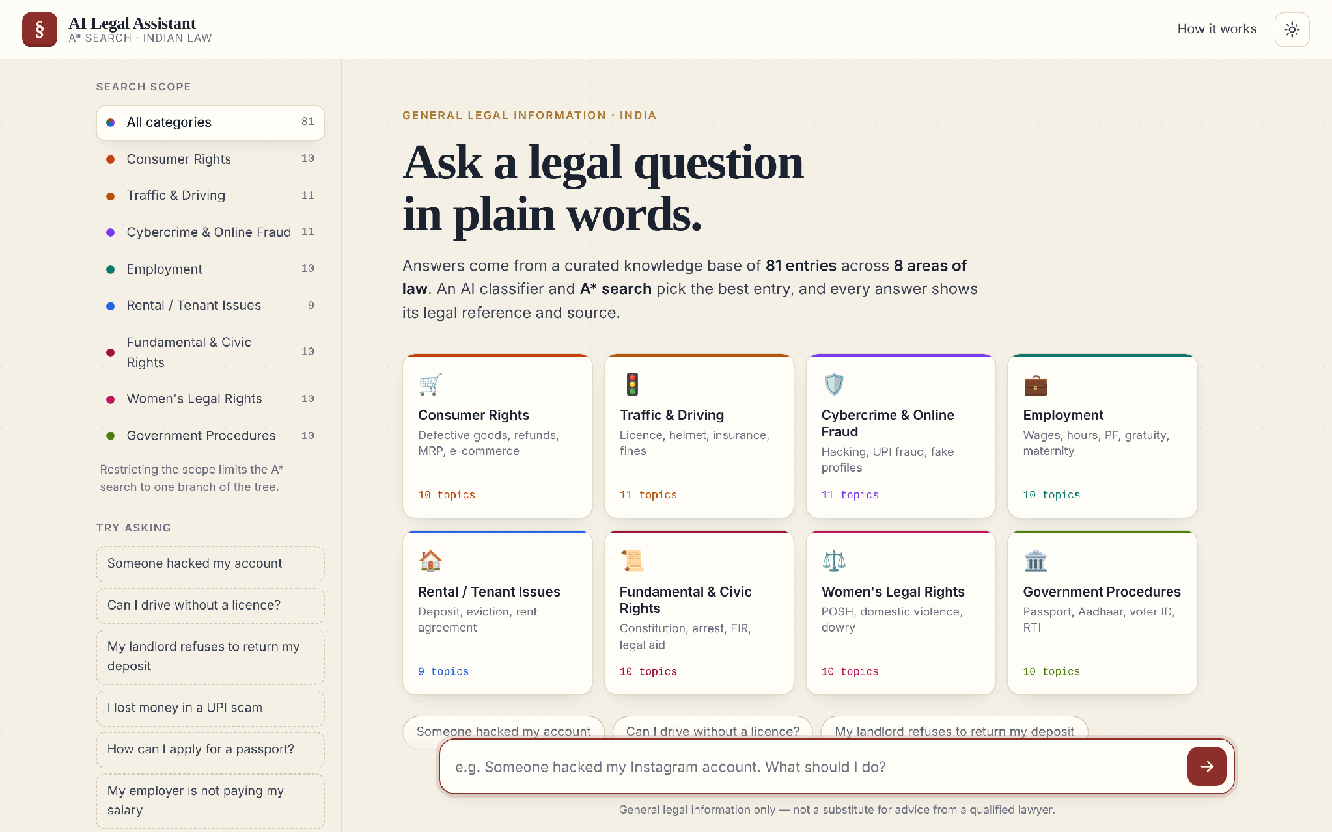
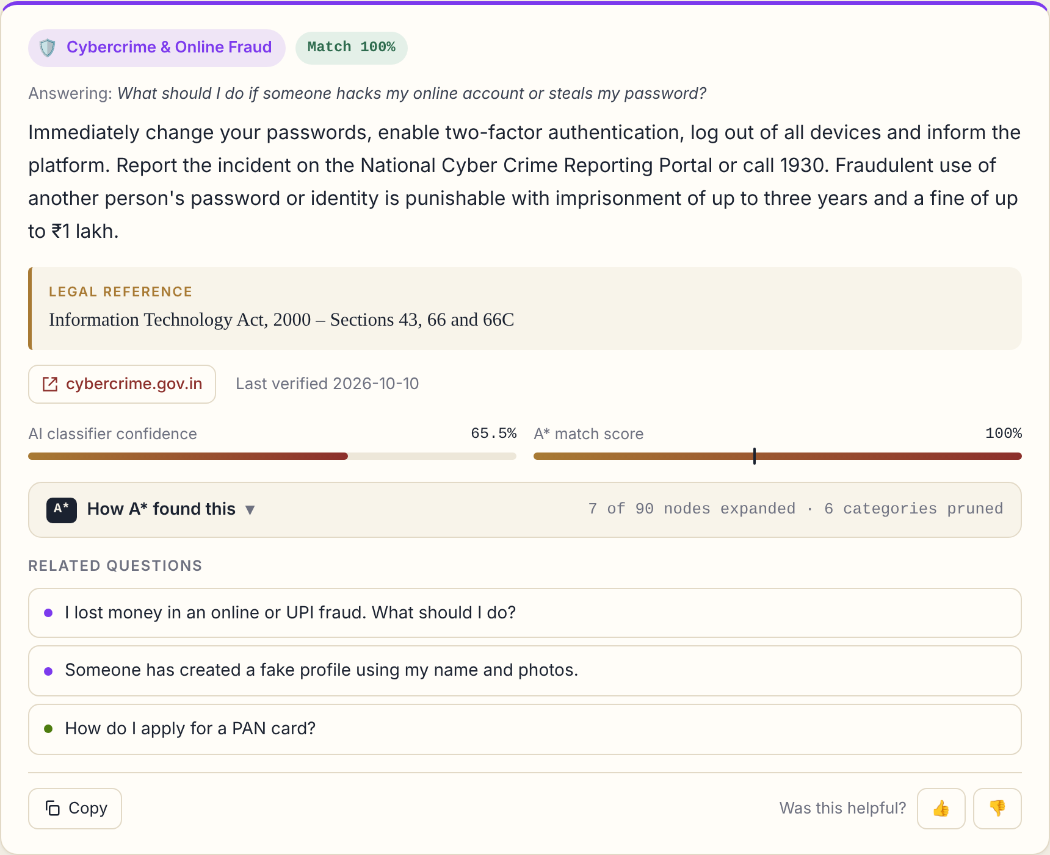
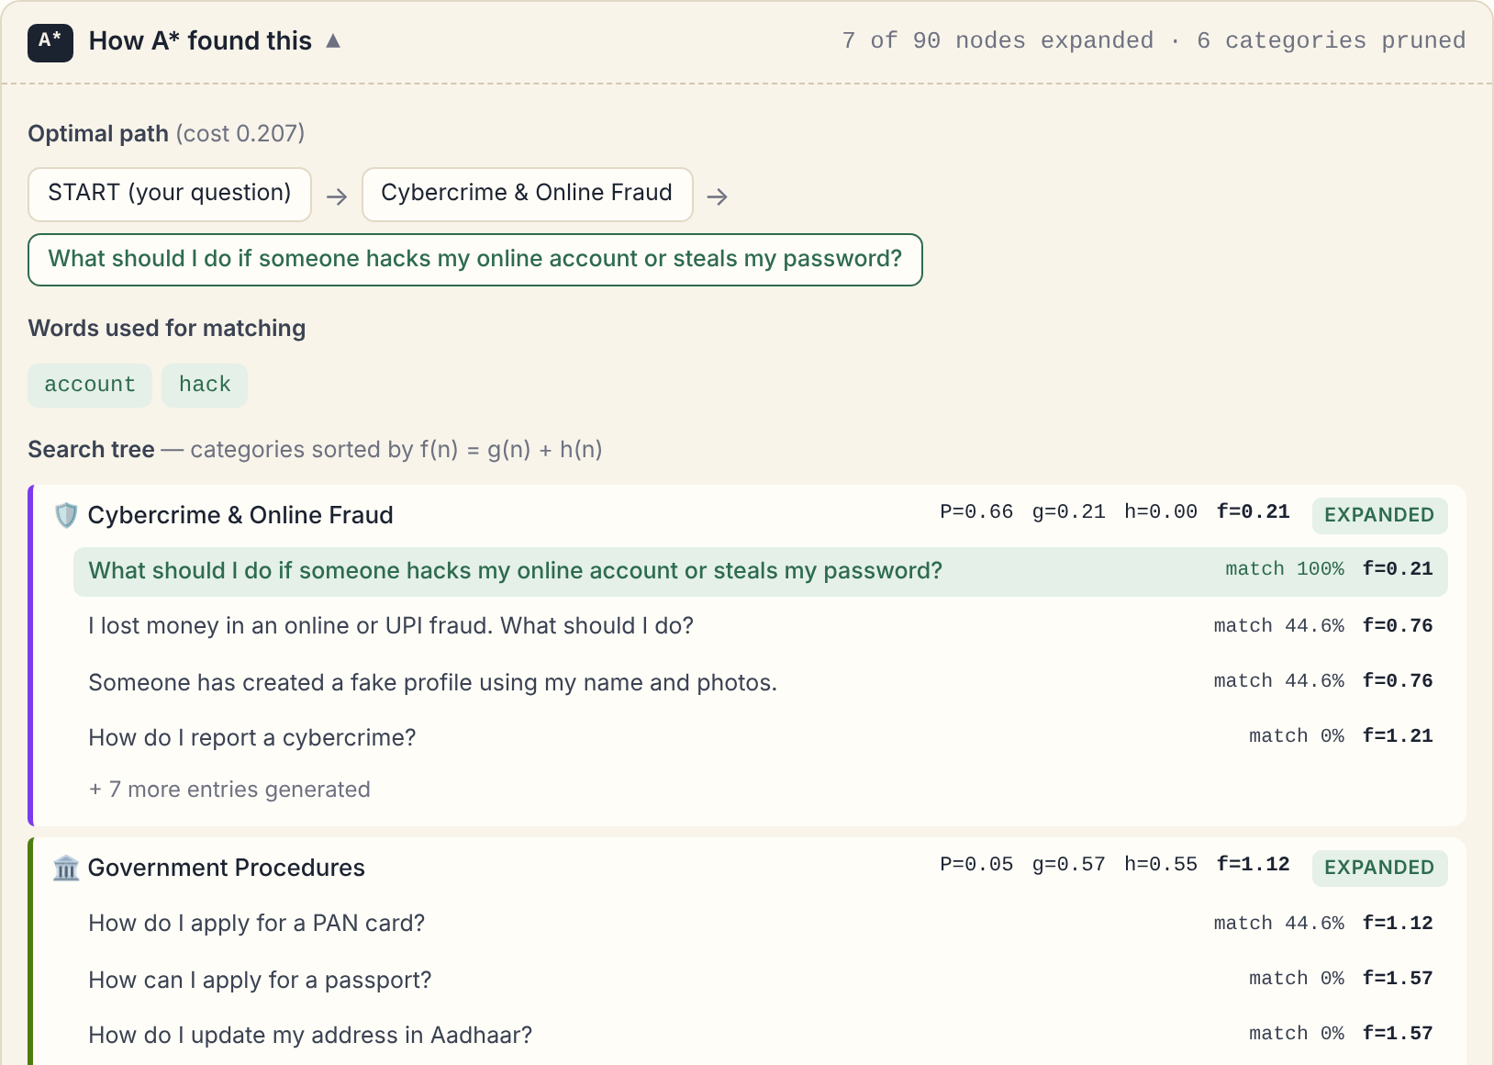
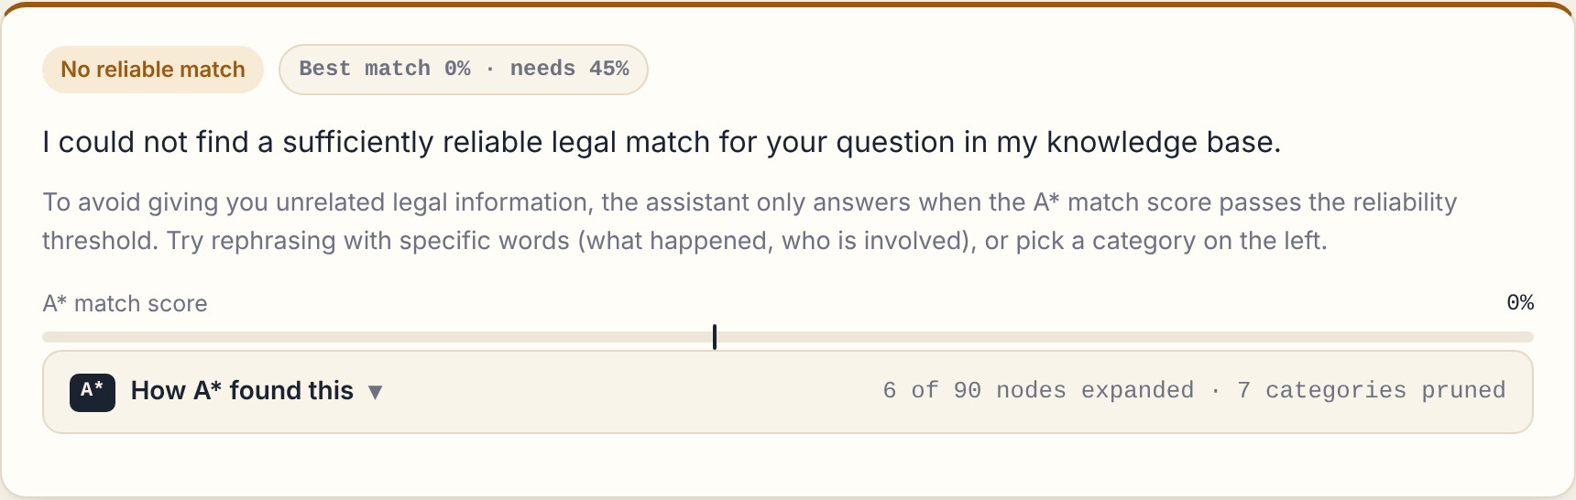
Output Screenshots
Home screen — 8 legal categories, search scope and sample questions
Answer with legal reference, official source, confidence and match score
A* trace — optimal path, matched words, expanded and pruned nodes
Out-of-scope question (divorce) safely rejected below the threshold
Notes:
Demo flow: home screen, then 'Someone hacked my account' showing the cybercrime answer with IT Act 66C and cybercrime.gov.in; open the A* panel to show g, h, f and pruned categories; finally ask about divorce to show the safe rejection.

Slide 8
Conclusion & Future Enhancements
CONCLUSION
FUTURE ENHANCEMENTS
8/8
40/40
93%
1
Multilingual
Tamil, Hindi and other Indian languages
report test cases passed
test questions answered
of nodes never expanded
Combined supervised learning (Unit V) with A* informed search (Unit II) inside an intelligent agent (Unit I).
Admissible heuristic guarantees the optimal entry while pruning most of the search space.
Reliability threshold prevents unrelated legal answers; every answer cites the law and an official source.
Transparent: the A* trace explains why an answer was chosen.
2
Voice input
speak a question, hear the answer
3
Larger knowledge base
more Acts, states and procedures
4
Auto-verification
periodic checks against India Code and gov portals
5
Document search
A* over sections of uploaded Acts and notices
Notes:
Summarise results and syllabus mapping, then mention limitations (English only, selected topics, needs periodic verification) and the planned enhancements.

Slide 9
References
[1] P. E. Hart, N. J. Nilsson and B. Raphael, “A Formal Basis for the Heuristic Determination of Minimum Cost Paths,” IEEE Trans. Systems Science and Cybernetics, vol. 4, no. 2, pp. 100–107, 1968.
[2] H. Zhong, C. Xiao, C. Tu, T. Zhang, Z. Liu and M. Sun, “How Does NLP Benefit Legal System: A Summary of Legal Artificial Intelligence,” in Proc. 58th Annual Meeting of the ACL, pp. 5218–5230, 2020.
[3] I. Chalkidis, M. Fergadiotis, P. Malakasiotis, N. Aletras and I. Androutsopoulos, “LEGAL-BERT: The Muppets straight out of Law School,” in Findings of EMNLP 2020, pp. 2898–2904, 2020.
[4] M. Queudot, É. Charton and M.-J. Meurs, “Improving Access to Justice with Legal Chatbots,” Stats, vol. 3, no. 3, pp. 356–375, 2020, doi: 10.3390/stats3030023.
[5] S. Paul, A. Mandal, P. Goyal and S. Ghosh, “Pre-trained Language Models for the Legal Domain: A Case Study on Indian Law,” in Proc. 19th Int. Conf. on Artificial Intelligence and Law (ICAIL), 2023.
[6] S. Russell and P. Norvig, Artificial Intelligence: A Modern Approach, 4th ed. Pearson, 2020.
[7] F. Pedregosa et al., “Scikit-learn: Machine Learning in Python,” Journal of Machine Learning Research, vol. 12, pp. 2825–2830, 2011.
[8] Government of India — India Code (indiacode.nic.in), National Cyber Crime Reporting Portal (cybercrime.gov.in), e-Daakhil (edaakhil.nic.in).
Notes:
References [1]–[5] are the literature survey papers; [6] is the course textbook for A* and agents; [7] is the ML library; [8] lists the official legal sources used in the knowledge base.

Slide 10
Thank You
Questions & discussion
Notes:
Thank the panel and invite questions. Be ready to explain why the heuristic is admissible and how the threshold prevents wrong answers.

